Slide 1


Activity Lifecycle, Multi-screen Apps, Kotlin
Speaker:
Andrii Rudyk

Slide 2
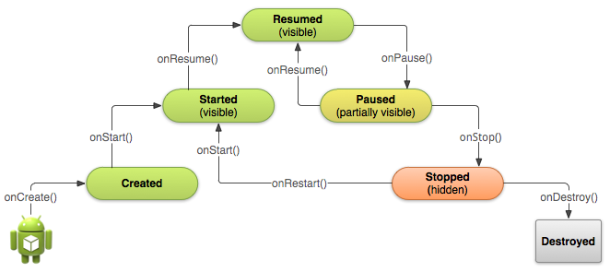
Activity Lifecycle

Slide 3
Activity Lifecycle
A good implementation of the lifecycle callbacks can help ensure that your app avoids:
Crashing if the user receives a phone call or switches to another app while using your app.
Consuming valuable system resources when the user is not actively using it.
Losing the user's progress if they leave your app and return to it at a later time.
Crashing or losing the user's progress when the screen rotates between landscape and portrait orientation.

Slide 4
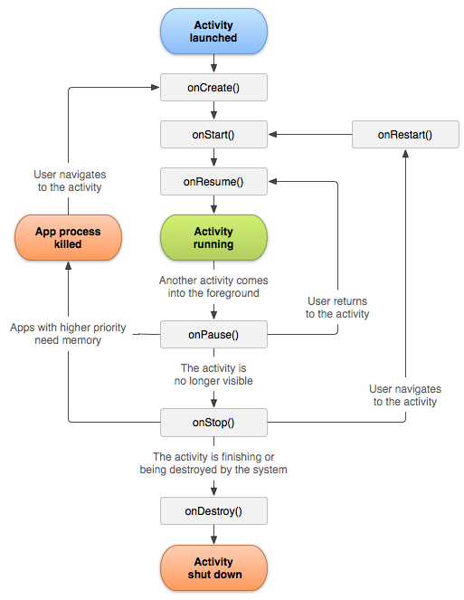
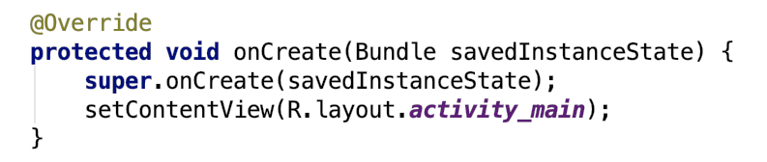
Activity Lifecycle - onCreate()
The first callback method and it fires when the system creates an activity for the first time. During the activity creation, activity entered into a Created state.

Slide 5

Activity Lifecycle - onStart()
The onStart() callback method will invoke when an activity entered into Started State by completing onCreate() method. The onStart() method will make an activity visible to the user and this method execution will finish very quickly.

Slide 6

Activity Lifecycle - onResume()
In this state activity start interacting with user that means user can see the functionality and designing part of an application on the single screen. Mostly the core functionality of an app is implemented in onResume() method.

Slide 7

Activity Lifecycle - onPause()
The paused activity does not receive user input and cannot execute any code and called when the current activity is being paused and the previous activity is being resumed.

Slide 8
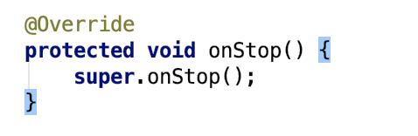
Activity Lifecycle - onStop()
The system will invoke onStop() callback method when an activity no longer visible to the user, the activity will enter into Stopped state. This happens due to current activity entered into Resumed state or newly launched activity covers complete screen or it’s been destroyed. The onStop() method is useful to release all the app resources which are no longer needed to the user.

Slide 9
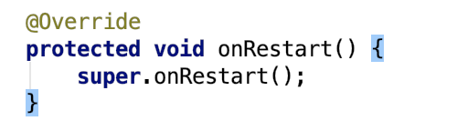
Activity Lifecycle - onRestart()
The system will invoke onRestart() method when an activity restarting itself after stopping it. The onRestart() method will restore the state of activity from the time that is being stopped.

Slide 10
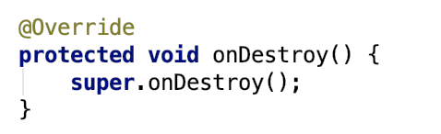
Activity Lifecycle - onDestroy()
The system will invoke onDestroy() method before an activity is destroyed and this is the final callback method which received by the android activity. The system will invoke this onDestroy() callback method either the activity is finishing or system destroying the activity to save space.

Slide 11
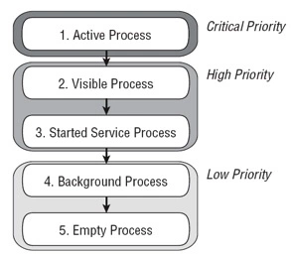
Overview of memory management
The Android Runtime (ART) and Dalvik virtual machine use paging and memory-mapping (mmapping) to manage memory. This means that any memory an app modifies—whether by allocating new objects or touching mmapped pages—remains resident in RAM and cannot be paged out.

Slide 12
Garbage collection
A managed memory environment keeps track of each memory allocation. Once it determines that a piece of memory is no longer being used by the program, it frees it back to the heap, without any intervention from the programmer. The mechanism for reclaiming unused memory within a managed memory environment is known as garbage collection.
Android’s memory heap is a generational one, meaning that there are different buckets of allocations that it tracks, based on the expected life and size of an object being allocated. For example, recently allocated objects belong in the Young generation. When an object stays active long enough, it can be promoted to an older generation, followed by a permanent generation.

Slide 13
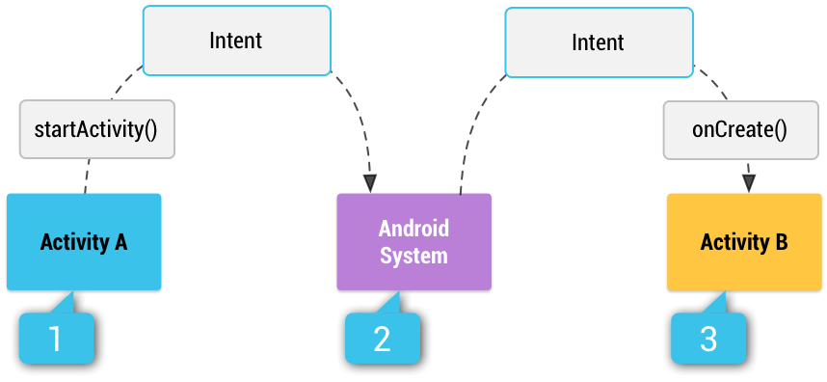
Intents
In android, Intents are the objects of android.content.Intent type and intents are mainly useful to perform following things:
Starting an Activity
Starting a Service
Delivering a Broadcast
The Intent object in android is having a following characteristics to help android system to understand which component should start:
Component Name
Action (ACTION_VIEW, ACTION_SEND, etc)
Data
Category(CATEGORY_LAUNCHER, CATEGORY_BROWSABLE, etc)
Extras
Flags

Slide 14
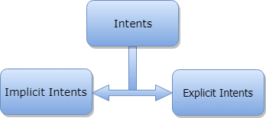
Intents
Explicit intents specify which application will satisfy the intent, by supplying either the target app's package name or a fully-qualified component class name
Implicit intents do not name a specific component, but instead declare a general action to perform, which allows a component from another app to handle it

Slide 15
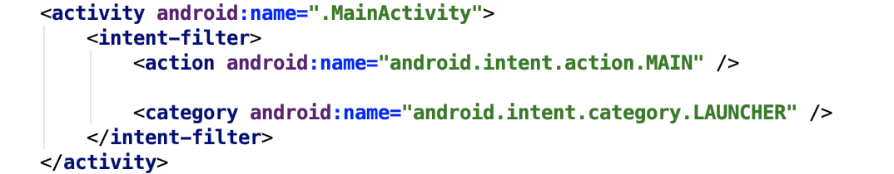
Intent Filters
To advertise which implicit intents your app can receive, declare one or more intent filters for each of your app components with an <intent-filter> element in your manifest file. Each intent filter specifies the type of intents it accepts based on the intent's action, data, and category. Inside the <intent-filter>, you can specify the type of intents to accept using one or more of these three elements:
<action>
<data>
<category>

Slide 16

What is a Kotlin?
Statically typed programming language for JVM, Android and the browser - developer since 2010 by JetBrains
Similar to Java, but free of its legacy problems and limitations
Can be freely mixed with Java (6+), existing codebase,ecosystem (Maven, Gradle), libraries etc.
Benefits: improved safety (no NPEs), increased readability(minimum boilerplate), added missing features
Easy learning curve (similar to Java/C#/JS), modern & fun!

Slide 17
Kotlin features
Null safety
No checked exceptions
Extension functions
Higher-order functions
Function types & lambdas
Default & named arguments
Properties
Type inference
Operator overloading
Smart casts
Data classes
Immutable collections
Enhanced switch-case
String interpolation
Ranges
Inline functions
Infix notation
Tail recursion
Coroutines (async/await)
Great Standard Library

Slide 18
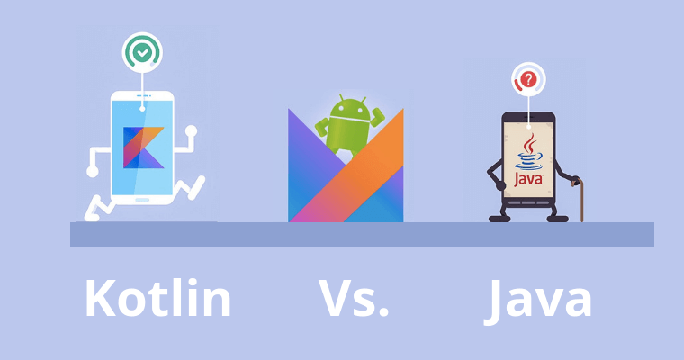
Let’s compare

Slide 19
Java
Kotlin
Optional values
String stringValue = "";
stringValue = null; // OK, now value is null for "stringValue" variable
stringValue.hashCode(); // NullPointerException (NPE)
var stringValue: String = ""
stringValue = null // ERROR. Compilation error: "Null cannot be a value of non-null type".
stringValue.hashCode()

Slide 20
Java
Kotlin
Optional values
String stringValue = "";
stringValue = null; // it works, now value is null for "stringValue" variable
if (stringValue != null) {
stringValue.hashCode(); // OK.
}
var stringValue: String? = ""
stringValue = null // OK. Value type is “String?” (optional String)
stringValue?.hashCode() // Safe call for optional values. If it’s null - it will be ignored.

Slide 21
Java
Kotlin
Functions
public int sum(int a, int b) {
return a + b;
}
You can use one of this function declaration styles:
This one
fun sum(a: Int, b: Int): Int = a + b
Even this one
fun sum(a: Int, b: Int) = a + b // Return type is automatically casted to Int
And
fun someFunction(a: Int, b: Int) = 3 // result will be static, 3, return type is Int automatically
fun someFunction(a: Int, b: Int) = “Result string” // result will be static, return type is String automatically

Slide 22
Java
Kotlin
Function arguments
Declaration:
public void showError (String message, int errorCode) {
// ...
}
Call:
showError("", 0);
Declaration:
fun showError(message: String, errorCode: Int) {
// ...
}
Call:
showError("", 0)

Slide 23
Java
Kotlin
Function arguments
Declaration:
public void showError (String message, int errorCode) {
// ...
}
Call:
showError("", 0);
Declaration:
fun showError(message: String, errorCode: Int) {
// ...
}
Call:
showError("", 0)
Or you can use named call:
showError(errorCode = 0, message = “”) // ordering of named parameters doesn’t matter
Note:
showError(“”, errorCode = 0) // Correct.
showError(message = “”, 0) // ERROR. You should pass non named params firstly.
showError(0, message = “”) // ERROR. You should pass non named params in declared order (message, errorCode).

Slide 24
Java
Kotlin
Function overloading
Declaration:
public void showError(String message, int errorCode) {
// ...
}
public void showError(String message) {
showError(message, 0);
}
Call:
showError("") // calling showError with single argument.
showError("", 1) // calling showError with two arguments.
Declaration:
fun showError(message: String, errorCode: Int = 0) {
// ...
}
Call:
showError("") // correct. errorCode have default value, you can pass only the first one argument
showError("", 1) // correct. pass both arguments.

Slide 25
Java
Kotlin
Mutability
String stringValue = "";
stringValue = "Another value"; // OK. All values are mutable in java.
var stringValue: String = ""
stringValue = "Another value" // OK. Value is mutable, so you can reassign it.
val stringValue: String = ""
stringValue = "Another value"// ERROR. Value is immutable, so you can’t reassign it.
Note:
Function arguments are always immutable.

Slide 26
Java
Kotlin
Classes and default constructors
public class Person {
private String name;
private Integer birthdayYear;
public Person(String name, Integer birthdayYear) {
this.name = name;
this.birthdayYear = birthdayYear;
}
public Person(String name) {
this(name, 1970);
}
}
class Person ( val name: String = “”, val birthdayYear: Int = 1970)

Slide 27
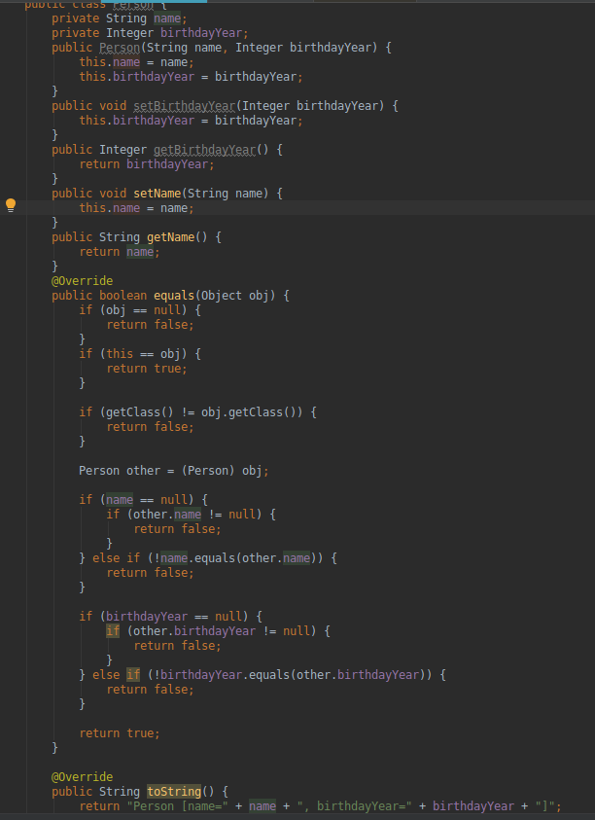
Java
Kotlin
Data classes
data class Person(val name: String, val birthdayYear: Int)

Slide 28
Java
Kotlin
Data classes
data class Person(val name: String, val birthdayYear: Int)
Features of data classes:
No need to override hashcode and equals method
No need to override toString method
Method “copy” which creates new instance of this class with the same variables as for called class.
Sample:
val john = Person("John", 1970)
val peter = john.copy(name = "Peter")
john.toString() // Person(name=”John”, birthdayYear=1970)
peter.toString() // Person(name=”Peter”, birthdayYear=1970)

Slide 29
Java
Kotlin
Extensions
Doesn’t support at all.
You can add extensions as functions or computed properties.
data class Person(val name: String, val birthdayYear: Int)
Extension function:
fun Person.formattedName(): String { // OK.
return "$firstName $lastName"
}
Extension property:
val Person.formattedName: String
get() = "$firstName $lastName" // OK. Computed properties are good for extensions.
var Person.formattedName: String
get() = "$firstName $lastName" // ERROR. You can’t store any data in extensions, so you can’t use var.
Calling:
val john = Person("John", "Wills")
john.formattedName // OK. “John Wills”
john.formattedName() // OK. “John Wills”

Slide 30

Thank you!

